Slide 1
Epicureanism Dr. Stephanie Spoto sspoto@mpc.edu Monterey Peninsula College
Gentrain
27 November 2018

Slide 2
What is an epicurean?

Slide 3
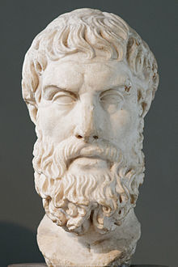
Epicureanism
Epicureanism is a system of philosophy based on the teachings of Epicurus (307 BCE)
Greatest good is to seek modest pleasures in order to attain a state of tranquility:
freedom from fear ("ataraxia")
absence from bodily pain ("aponia").
Together, these states are held to constitute happiness in its highest form.
Epicureanism as Hedonism? Yes, technically. But Epicureanism defines happiness as the absence of pain, and advocates the simple life.
Portrait of Epicurus, founder of the Epicurean school. Roman copy after a lost Hellenistic original.

Slide 4
Some sources

Slide 5
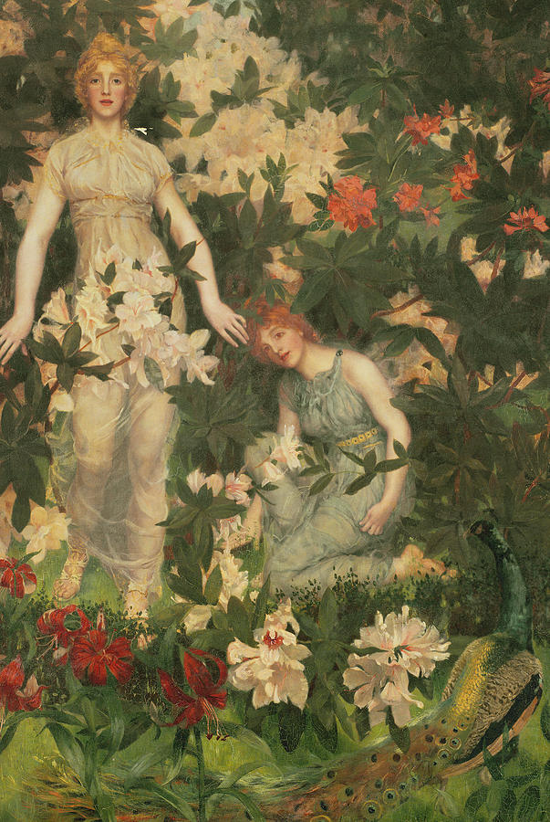
The Pleasure Garden
Seneca thought that Epicurus hid himself outside of Athens to avoid notice or controversy.
Garden just outside a gate of Athens
Inscription at the gate of the garden: “Stranger, your time will be pleasant here. Here the highest good is pleasure.” (In Seneca’s Latin: hospes hic bene manebis hic summum bonum voluptas est).
Inscription to Plato’s Academy: “Let no one unversed in geometry enter here.”
Leontium and Ternissa in the Garden of Epicurus by Williams Stott (1913-1989)

Slide 6
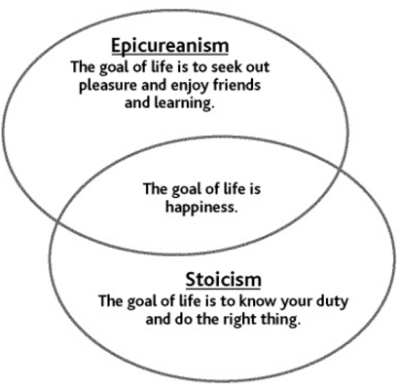
Pleasure through knowledge
Tranquility could be obtained through the knowledge of the workings of the world and the limiting of desires.
Pleasure was to be obtained by knowledge, friendship and living a virtuous and temperate life.
He lauded the enjoyment of "simple pleasures", by which he meant abstaining from bodily desires, such as sex and appetites, verging on Asceticism.
“A cheerful poverty is an honorable state".

Slide 7
Epicureanism and indulgence
Moderation in all things
Eating: food should not be too rich, because it could lead to pain later (e.g. indigestion)
Sex: sex could lead to more lust and therefore dissatisfaction → Epicurus was celibate
Learning: Even this was discouraged if it might disturb peace of mind → learning always good if helped rid oneself of fear and superstition
Not about pleasure, as much as avoiding pain

Slide 8
Shunning politics Thinking Justice
Epicureans shunned politics as having no part in the quest for ataraxia and aponia → a potential source of unsatisfiable desires and frustration, which was to be avoided (as pain).
Justice as social contract: “neither to harm no be harmed” (Principle Doctrines)
Laws and punishments in society are important so that individuals can be free to pursue happiness
just laws are those that contributes to promoting human happiness.
In some respects, this was an early contribution to the much later development of Liberalism and of Utilitarianism.
Epicurus as depicted in the Nuremberg Chronicle (a late 15th-century book.

Slide 9
Unpopular Epicurean Beliefs
Epicurean gods are remote and impersonal
Can not be provoked to anger
No divination or prophecy
No personal life after death → no cult of the dead
World not designed to perfection, but the result of random combinations of atoms in an infinite void
Philosophers concerned with religious or political life offended by Epicurus’s avowed withdrawal from public life in Athens (Cicero, Seneca, Plutarch)
Like Democritus and Leucippus before him, Epicurus was an Atomist, believing that all matter, souls and gods are all comprised of atoms, and even thoughts are merely atoms swerving randomly.

Slide 10
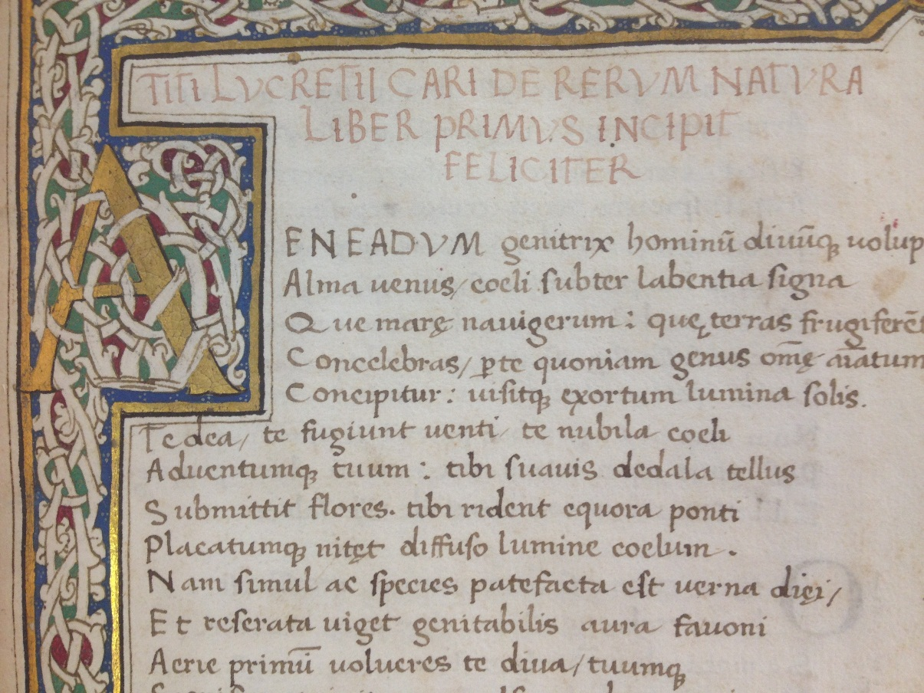
Epicureanism in Rome
Originally conceived as a challenge to Platonism.
Along with Stoicism and Skepticism, the school of Epicureanism later became one of the three dominant schools of Hellenistic philosophy, lasting strongly through the later Roman Empire.
A manuscript of De Rerum Natura in the Cambridge University Library collection, c1560
Lucretius (99 - 55 BCE) was the school's greatest Roman proponent, composing an epic poem, "De Rerum Natura" ("On the Nature of Things") on the Epicurean philosophy of nature.
The poet Horace (65 - 8 BCE)
Julius Caesar (100 - 44 BCE)

Slide 11
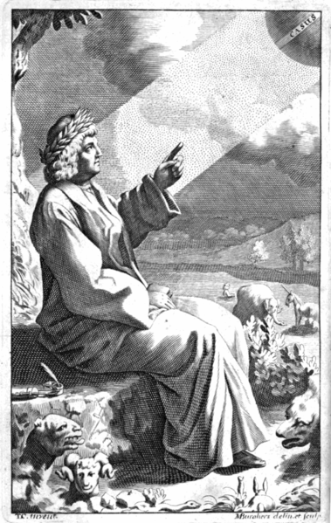
Lucretius
First writer to introduce Roman readers to Epicureanism
Mainly Epicurean physics, atomism, explanations of thought
World guided by fortune (chance), and not the intervention of gods
Letter from Cicero to his brother Quintus in 54 BCE: "The poems of Lucretius are as you write: they exhibit many flashes of genius, and yet show great mastership."
Lucretius. Drawn and engraved by Michael Burghers. From the frontispiece to Thomas Creech, T. Lucretius Carus, Of the Nature of Things, London 1714.

Slide 12
Epicureanism and Christianity
Official approval of Christianity by the Roman Emperor Constantine (272 – 337 CE) in 313 CE
Epicureanism was repressed as essentially irreconcilable with Christian teachings
The school endured a long period of obscurity and decline.
Conflict:
Gods are uncaring and impersonal
No afterlife

Slide 13
“The Paradox of Epicurus”
Sometimes known as the “Problem of Evil”
If God is willing to prevent evil, but is not able to, then He is not omnipotent; if He is able, but not willing, then He is malevolent; if He is both able and willing, then why is there such a thing as evil; and if He is neither able nor willing, then why call Him God at all?
Lactantius attributes this riddle to Epicurus in De Ira Dei

